Slide 1
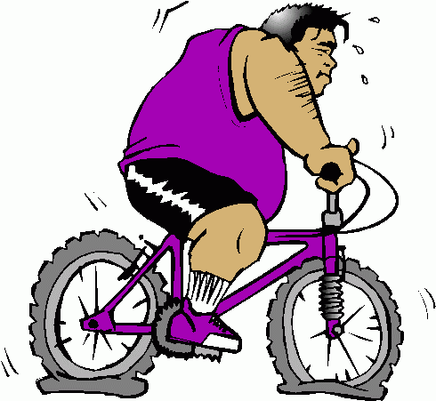
Exothermic reactions
Small amount of energy in to break bonds
Large amount of energy out when new bonds form
This much energy given out = exothermic

Slide 2
Endothermic reactions
Large amount of energy in to break bonds
Small amount of energy out when new bonds form
This much extra energy required = endothermic

