Slide 1
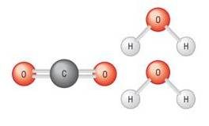
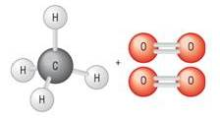

Enthalpy cycle:
Route 1
Start
Finish
Reactants
Bond | No | Bond enthalpy | Total
C - H | 4 | +413 | +1652
O = O | 2 | +497 | +994
Σ (Bond enthalpies of bonds broken) = |  |  | +2646
Reactants
Bond | No | Bond energy | Total
C = O | 2 | +805 | +1610
O - H | 4 | +463 | +1852
Σ (Bond enthalpies of bonds broken) = |  |  | +3462
Route 2
+ 2646
- 3462
Route 2 = + 2646 + - 3462
Route 2 = - 816 Kj Mol⁻¹
Hess’s Law:
Route 1 = Route 2
Route 1 = - 816 Kj Mol⁻¹

